Slide 1


WEB SERVER
VS
APPLICATION SERVER
Ignite+

Slide 2

WEB SERVER
A web server is server software, or hardware dedicated to running said software, that can satisfy World Wide Web client requests. A web server can, in general, contain one or more websites. A web server processes incoming network requests over HTTP and several other related protocols.

Slide 3








06

Slide 4
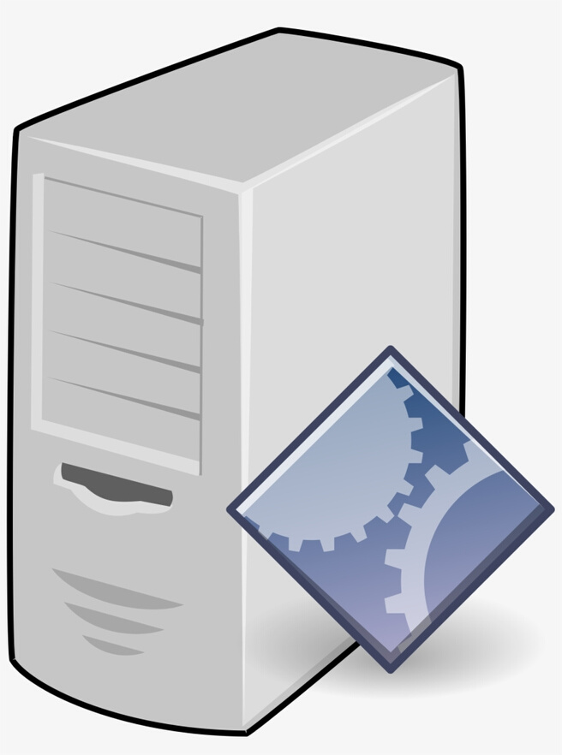
APPLICATION SERVER
An application server is a software framework that provides both facilities to create web applications
and a server environment to run them.

Slide 5








Slide 6
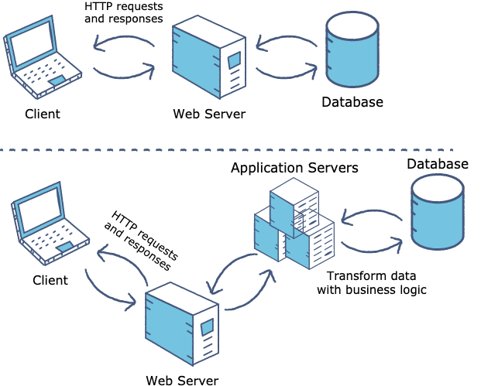
WORKING

Slide 7
WEB
SERVERS
APPLICATION SERVERS

Slide 8
Application Server supports distributed transaction and EJB.
Application Server can contain web server in them. most of App server e.g. JBoss or WAS has Servlet and JSP container.
Web Server supports Servlets and JSP.

Slide 9
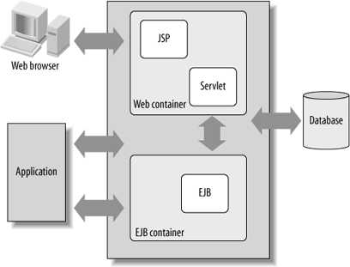

Slide 10
Web server is useful or fitted for static content.
Application server is fitted for dynamic content

Slide 11
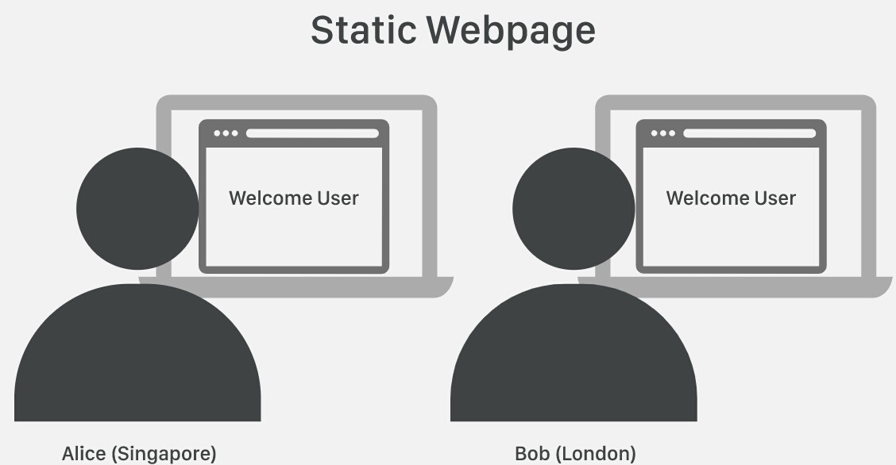

Slide 12
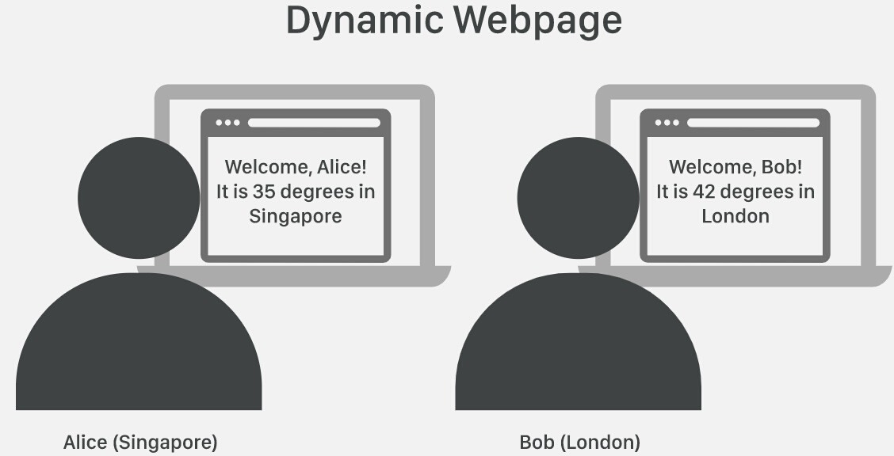

Slide 13
Web server consumes or utilizes fewer resources.
While application server utilise more resources.

Slide 14
Application server’s capacity is higher than web server
Web server’s capacity is lower than application server.

Slide 15
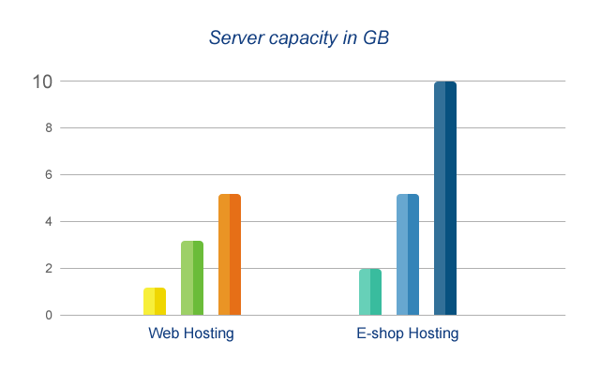

Slide 16
14
While application servers arrange the run environment for enterprises applications.
Web servers arrange the run environment for web applications.

Slide 17
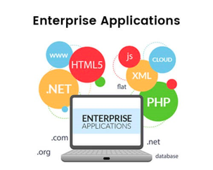
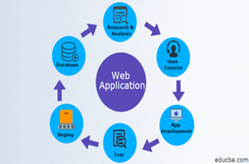



Slide 18
While in application server, multithreading is supported.
In web servers, multithreading is not supported.

Slide 19
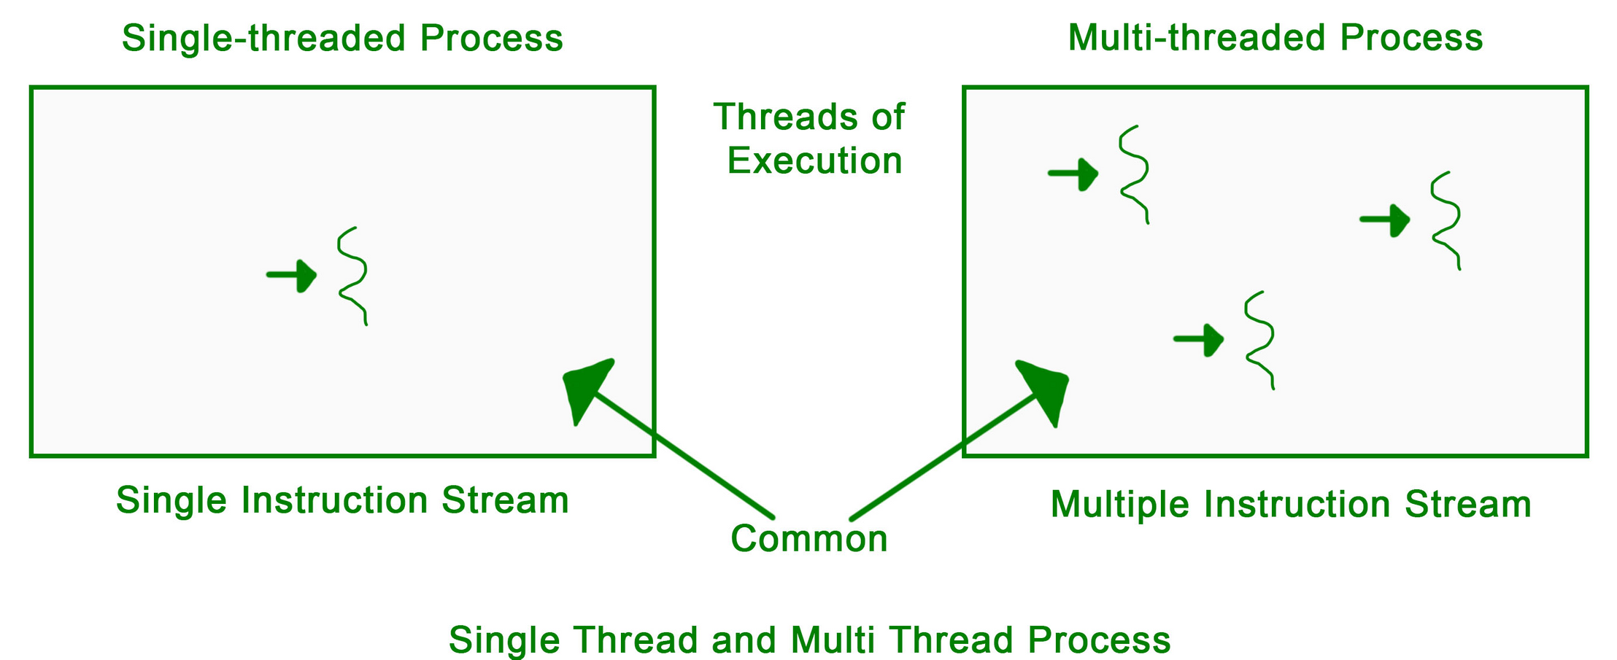

Slide 20




While in this, GUI as well as HTTP and RPC/RMI protocols are used.
In web server, HTML and HTTP protocols are used.

Slide 21


THANK YOU!

